Slide 1


Slide 2

OTS Statewide webinar
Outcome Tracking System
Lindsay Terry Stine
Data and Analytics Manager
Outcome Tracking System Data Website

Slide 3
Agenda
Meet your team
Importance of Data
Goals
Reporting Period
15-day Pull
OhioISP
CB ran ICFs
Dashboard Queues
OTS Questions
Reminders
Resources
Ohio Administrative code
Updates
Bugs Fixes/Enhancements
Timelines
Questions
Data Entry
Pre-Population
What is OTS?

Slide 4
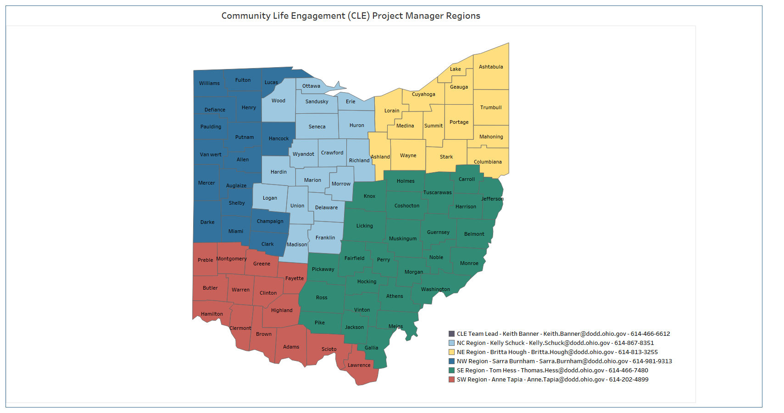
Meet your team

Slide 5
What is ots?
OTS is a tool to collect information about how people are spending their days
  Does not focus on individual outcomes identified within a person’s plan
  Focuses on the larger systems outcomes that are happening with services
  Allows DODD to align policies, procedures, and legislation that will improve how people live, work, and play in their communities
Notes:
EF OTS closed 6/14/2019
4 variables were pulled over to OTS from EF OTS as of 6/14/2019.
Collaboration with Supported Employed Leadership Network (SELN).
Easy to gain access
Easy to enter data
Easy to access data
The EF OTS application was developed in 2014 in response to Ohio’s Employment First Initiative Governor Kasich signed the EF Executive Order on March 19, 2012, making Ohio one of 26 states with an official Employment First policy or legislation. The EF Initiative set forth that competitive employment in an integrated setting should be the priority outcome for people with disabilities. An EF Advisory Committee and Taskforce was created and charted with expanding community employment opportunities by reducing barriers.
(The EF rule 5123-2-2-05 was created to support the EF Initiative. This rule applies to those responsible for planning, coordinating, or providing employment services regardless of funding services.)
The EF Taskforce recommended that a statewide data collection system be created to better understand and track how individuals with I/DD within employment services (regardless of funding) were employed. EF OTS was developed to better understand what was happening with the DD Service System when someone was employed to make data driven decisions. The EF OTS was launched in February 2014 and the EF Taskforce indicated that they want to see that 50% of individuals with I/DD be competitively employed by 2024.
The Outcome Tracking System replaced the Employment First Outcome Tracking System in October 2019. It focuses on the larger systems outcomes that are happening with services (and not the individual outcomes identified in a person’s plan), and this data allows us to align policies, procedures, and legislation in order to improve how people live, work, and play in their communities.

Slide 6

Importance of data
Data is facts or information collected for a purpose and used to calculate, analyze, understand, or plan something.
Most powerful tool for agencies!
Leads to increased understanding and identifies trends and patterns.
Essential for policy planning!
Decreases risk and results in consistent improvement.
Allows us to measure progress.
Quality of life matters – this is just a snapshot of data.
Notes:
Informs, engages, and creates opportunities!
Data is facts or information collected for a purpose and is used to calculate, analyze, understand, or plan something.
Data is the most powerful tool an agency can have. Data informs, engages, and creates opportunities for agencies. It provides meaning and relevance and can lead to increased understanding (and decreased uncertainty), and it makes connections that lead to insights and improvements. It also allows us to identify trends and patterns which assist us in adjusting the task at hand.
In our case, it allows us to understand how people with I/DD spend their days in Ohio.

Slide 7

Goals
85% Statewide Completion
Goal
October 14%
January 56%
December 42%
February 70%
March 85%
November 28%
Notes:
RP24 we were 82%

Slide 8
Updates
Changes to the Questions
  Removed ADS Question and Sub-Questions
  Changed wording in Group Integrated Job → “Name of Employer” to “Name of Business” and “Is the Employer a Medicaid Provider” to “Is the Business a Medicaid Provider”
  Adding Occupation to Group Integrated Job
Place on the Path to Community Employment
Monthly Q&A sessions have been absorbed into regional Community of Practices
Updated 1:1 sessions via your regional Community Life Engagement Project Manager
Notes:
Please proceed with submitting plans as usual. To ensure clarity, we ask that you include a note in the Skills and Abilities section of the Daily Life and Employment summary that describes how your team is supporting the person in alignment with their correct Place on the Path. No citations will be issued. Please do not submit tickets.

Slide 9
Bug Fixes/Enhancements
Pre-Population responses
County Board ran ICF Questionnaires
Adding number of Unassigned Records to Master Report
“CB-ICF” flag added to Master Report
Ring counts, Advanced Search counts, Performance Report counts match
Other text fields that have an error message due to 2,000+ characters

Slide 10
Bug Fixes/Enhancements
Data Tables warning when click enter instead of search button – message
Added Provider Status to the Performance Report
Will be able to export the Questionnaire Queue list to Excel
Fringe Benefits not working in a Pre-Population Questionnaire
Updating wage/hours validation decimals

Slide 11
timelines
15 September 2025
15-day pull happens
1 October 2025
Opening day of the 2025 Reporting Period
31 March 2026
Last day of Reporting Period
14 September 2025
Last day to update information prior to the 15-day pull
15 September 2024
The first day that RP25 can pull claims for Questionnaires for this Reporting Period.
Last day that RP25 can pull claims for Questionnaires for this Reporting Period.
Static snapshot of data – no updates can occur
Ends at 11:59pm

Slide 12
Reporting period
Yearly Snapshot
Providers enter data on those they serve in the month of September
CBs & ICFs Assign Records to the appropriate provider(s)
Reporting Period ends March 31st (typically)
Read-Only after Reporting Period ends
Reports
Reporting Period opens October 1st
Providers have 6 months to complete Questionnaires
Notes:
15 day pull
Nothing can be added once Reporting Period is opened

Slide 13
15-day Pull criteria
Criteria 1 - Billing
Criteria 2 – S&S
Criteria 3 – ICF Residence
Criteria 4 - OhioISP
Billing
  Adult Day Supports
  Ohio Department of Aging – Adult Day Supports
  Vocational Habilitation
  Group Employment Supports
  Individual Employment Supports
  Career Planning Services
Individuals are “Active” in CRM-IDS
Services marked in CRM-IDS
  Adult Day Supports (Community or Facility)
  Ohio Department of Aging (Community or Facility)
  Vocational Habilitation (Community or Facility)
  Group Employment Supports
  Individual Employment Supports
  Career Planning
  Competitive Employment
Place on the Path to Community Employment (PPCE)
Gender
All individuals residing in the facility at the time of the 15-day pull
18 years or older
Place on the Path to Community Employment (PPCE)
Gender
Paid Supports
  IO Waiver, Level One Waiver, SELF Waiver
  ICF
  Local Funds/Local Funds – Contracted with Ohio Department of Aging
  Other
Provider Services
  Adult Day Support
  Vocational Habilitation
  Individual Employment Supports
  Group Employment Supports
  Career Planning
    Career Planning – Worksite Accessibility
    Career Planning – Assistive Technology Assessment
    Career Planning – Benefits Education and Analysis
Notes:
Data in OTS is static, it will not update if data is updated after the 15-day pull – it is a snapshot
Billing → 1 unit of service (Sept to Sept) that has been billed and processed prior to the 15-day pull
Paid Supports Section
OhioISP status = excludes only those plans that are in ‘Canceled’ status
Looks at the last 365 days (September to September)
Services include – Virtual, Community, Facility

Slide 14
Ots and the ohioisp
Local Funds
PPCE
Competitive Employment
Services and Supports
Pulled in from Services/Supports in CRM-IDS to both OTS and OhioISP
Source of truth is CRM-IDS (for now)
Data entered in CRM-IDS pulls into both OTS and the OhioISP
Check box in CRM-IDS pulls into OTS
Employment section in OhioISP
Pulls in locally funded and Competitively Employed into OTS
Adult Day and Employment services in OhioISP will pull into OTS
Notes:
Everyone of working age in Ohio is required by the EF Rule to participate in a person-centered planning process
During this process, individuals are required to identify their place on the path to community employment (PPCE)
There are 4 Places on the Path:
Place 1 – I have a job but would like a better one or to move up.
Place 2 – I want a job! I need help to find one.
Place 3 – I’m not sure about work. I need help to learn more.
Place 4 – I don’t think I want to work, but I may not know enough about it.
County Boards enter the PPCE in CRM-IDS in the Services and Supports Section
ICFs enter the PPCE in the Portal
PPCE will be pulled into the OTS 15 days prior to the Reporting Period

Slide 15
are you ready for the upcoming 15-day pull?
County board checklist
ICF/DC Checklist
Are individuals “Active” within DODD systems? Or “Terminated” if needed?
Have you updated the person’s Place on the Path to Community Employment?
Are the Services and Supports updated within CRM-IDS?
Have you selected “Competitive Employment” within CRM-IDS, if applicable?
Does the person have an identified gender and DOB entered in the DODD system?
Have you completed the Level of Care (LOC) process?
Has the Individual Transfer Record (ITR) process occurred?
Have you updated the person’s Place on the Path to Community Employment?
Does the person have an identified gender and DOB entered in the DODD system?

Slide 16
County Board ran Intermediate care facilities (icf)

Slide 17
County board ran intermediate care facilities (ICF)
Clark, Cuyahoga, Geauga, Jefferson, Lake, Licking, Lorain, Richland
Can assign from the Questionnaire Queue Questionnaires that should be completed by their ICF
  Will do so by:
    Selecting the Questionnaire (check the box beside the person’s name)
    Select the button ‘Modify CB-ICF’
    Questionnaire will be assigned to their CB ran ICF
    Validation message will indicate “You have successfully assigned the record for the ICF you operate”
Notes:
This only applies to these 8 counties and their CB ran ICFs
OTS Admin can remove the assignment if needed

Slide 18
Dashboard Queues

Slide 19
Assignment queue
Functionality for County Boards and ICFs
Ability to assign the appropriate provider(s) a record
Ability to self-assign as a County Board or ICF
  Competitive Employment – no supports
  Provided services with local funds
ICFs can only assign people residing in their facility
  Not those Questionnaires for those that were billed (if a dual provider)
Notes:
Discuss issues from last Reporting Period – creating “Local” providers and then assigning to “None at this time” or assigning a specific SSA.
Discuss examples of where a provider went out of business and what to do with the Questionnaires
Will only pull in “Waiver” type providers from PSM
Won’t pull in Vendor or Local providers
Discuss that CBs will see that they are considered a “waiver provider” – this is often a confusing concept

Slide 20
Questionnaire queue
Questionnaires that you are responsible for entering data
  Billed an Adult Day and/or Employment Service
  Assigned by a County Board or ICF
Search Functionality
Ability to begin the Questionnaire, save, and return later
Master Record for each person
  Can Print master record (ctrl + p)
Notes:
Can edit and delete within answering the questionnaire
Search functionality allows you to search for pieces of a word – does not work completely with PPCE – need to use advanced search for that
Master Record – read only document of all data entered for that individual by all providers – only will show entries that have been submitted at that time

Slide 21
Ots questions

Slide 22
Ots questions
2. . Is the person in Self-Employment?
4. Is the person in Facility-Based Work?
6. Are you providing the person Community-Based Non-Work Services?
1. Is the person in a Competitive Job?
5. Are you providing the person Facility-Based Non-Work Services?
3. Are you supporting this individual in a Group Integrated Job?

Slide 23
ENTERING DATA FOR THE FIRST TIME
Answer the 6 main questions
If “Yes” then sub-questions are populated
Ability to save and finish Questionnaires later
Ability to enter multiple jobs
System will not allow you to submit without all sub-questions answered
Review data entry within the Summary prior to submitting
Once Questionnaire is submitted, you are not able to edit
Notes:
Demo entering data for the first time
Will give you an error if you do not answer all sub-questions – demo
CBs responsible for entering data for those Competitively employed and not receiving supports
Must assign yourself the questionnaire if CB
Entering for September data only

Slide 24
Pre-population from previous reporting period
If answer “Yes” to the main questions, and indicated “Yes” in previous Reporting Period, data will automatically pre-populate
Crucial that you review and update the pre-populated answers

Slide 25
Reminders

Slide 26
Important reminders
Ensure you are reviewing the pre-population answers and update as needed
Updated Minimum Wage each year
Competitive Employment criteria – did the job meet the minimum requirements?
Who is responsible for entering the information
Average Wages per hour
Average Hours per week

Slide 27
Ohio administrative code

Slide 28
Administrative rule
Participation in the Outcome Tracking System is a requirement in the Employment First Rule 5123:2-2-05
“Providers of employment services shall collect and submit to the department individual-specific data regarding employment services and employment outcomes including but not limited to, type of services provided, how individuals obtained employment, hours worked, wages earned, and occupations. The data shall be submitted through a web-based data collection system developed and maintained by the department”
Notes:
Stress required vs. not required – ADS and ICF and PPCE vs. Employment providers.
ETA for ICF/DC/ADS requirement is ~?

Slide 29
Office of compliance
A report will be given to Compliance at the end of each Reporting Period
List of Non-Compliant providers (for the required questions)
Notes:
Tool question 7.016 agency tool – subject to change

Slide 30
Resources
OTS Data Website
1:1 Office Hours
Community Life Engagement (CLE) Project Managers
Community of Practices

Slide 31
We want to hear from you!
If you are having any issues within the OTS application, please reach out to us!
Please let your Regional Community Life Engagement Project manager know of any issues you may be experiencing, so we can address them quickly.

Slide 32


