Slide 1
Season 4 Episode 9 (March 26th 2024 9am – 10:30 am): Reporting Requirements

Slide 2
Today’s Episode
Introductions and context 9:00 am – 9:15 am
Overview of Reporting Requirements for Benefits Programs 9:15 am – 10:15 am
Next steps: Q+A, and Next Steps Poll 10:15 am – 10:30 am

Slide 3
Poll # 1: Who’s here today?
Service Support Administrator (SSA)
Other County Board staff
Family member
Self advocate
Provider
Opportunities for Ohioans with Disabilities (OOD)
Ohio Department of Developmental Disabilities (DODD)

Slide 4
F. E. A. R.
Facts
Evaluate
Action
Results

Slide 5
Purpose behind all Fear Factor Episodes:
Providing access to experts and resources to SSAs, jobseekers and employees with developmental disabilities, their families/supporters (and anyone else interested), so we can all face the fears around benefits and working and move forward with facts and confidence.

Slide 6
So far…
8 Episodes so far, covering SSI, SSDI, Medicaid, Ticket to Work, and Medicaid Buy In for Workers with Disabilities…
Published Fear Factor Working Document packed with info, resources and links around all aspects of Benefits and Working.
Shout out to FEAR Factor Fans! SSAs, providers, family-members, people being supported, and more.

Slide 7
So far…
In all episodes, we went through several fears around benefits and working and fielded questions.
We polled folks at the end of each episode to determine the topics, and Reporting Requirements was chosen for today’s session.

Slide 8
FEAR Factor Episodes on the Employment First Website
A Few Recent Episode Highlights:
Episode 7: Medicaid Buy In for Workers with Disabilities (June 28, 2023)
Episode 8: SSDI vs. SSI Just Give me the Basics (February 16, 2024)
All recordings and supporting docs available here.

Slide 9
Poll # 2: How much do you know about Reporting Requirements prior to today?
I have never heard about reporting requirements. I am supposed to report something? To whom?
I have heard of reporting requirements, but I don’t understand what to report.
I consider myself fairly knowledgeable about reporting requirements.
I believe I know as much as the presenter about reporting requirements.

Slide 10
“Fear Factor” Superstars
Paula Washek, Benefits and Supports Specialist, Clearwater Council of Government
Latosha Olinger, Work Incentives Coordinator, Warren County DD
Christine Brown, Clinical Research Assistant/Self Advocate Faculty, Ohio State Nisonger Center

Slide 11
“Fear Factor” Production Team
Elizabeth Risner, SSA Supervisor, Butler County Board of Developmental Disabilities
Christine Brown, Clinical Research Assistant/Self Advocate Faculty, Ohio State Nisonger Center
Nathan Turner, Advocacy Policy Specialist, Ohio Department of Developmental Disabilities
Tanya R. Chiles, Chiles Creations
Darenda Geer, Certified Work Incentive and Transitioning Youth Practitioner, DBS Consulting
Jeanne Ehmke, Work Incentives Consultant, Opportunities for Ohioans with Disabilities

Slide 12
On with the show!

Slide 13
Reporting Requirements to Maintain Benefits
Review Various Benefit Programs
What Needs to be Reported
How to Report

Slide 14
What needs to be reported?
EVERYTHING!!
Especially for the “needs based” programs

Slide 15
Social Security Disability Benefits
The Social Security Disability (Title II) program pays benefits to individuals and certain family members if they worked long enough and paid Social Security taxes. (Adult children also may qualify for benefits on parent’s earnings record if he or she has a disability that started before age 22.)
Social Security Disability Insurance (SSDI)
Childhood Disability Benefits (CDB) previously known as Disabled Adult Child (DAC)
The Supplemental Security Income (Title XVI / SSI) program pays benefits to disabled adults and children who have limited income and resources.

Slide 16
What are the differences?
Title XVI - SSI
Title II - SSDI / CDB
Needs based program
Resource limit $2,000 for individual $3,000 for a couple
Monthly income will reduce check amount
Individual also eligible for Medicaid
Full Benefit Rate for 2024 is $943 for individual and $1,415 for a couple
Check arrives on the 1st of the month
Insurance Program
NO resource limit
Medicare begins 24 months after check starts
Work income may cause check to cease
Benefit amount varies depending on how much was paid in and how many people are drawing off it
Check arrives on the 3rd of the month or on a Wednesday during the month

Slide 18
NEEDS BASED PROGRAMS
Social Security
SSI (Supplemental Security Income)
Job and Family Services
Medicaid
SNAP (Supplemental Nutrition Assistance Program)
OWF (Ohio Works First)
Local Housing Authority
Subsidized Housing (HUD / Section 8)

Slide 19
WHO needs to report to Social Security?
Representative Payee if there is one.
Make sure payee KNOWS when something needs reported
Individual if they are their own payee.
Don’t assume someone else is reporting.

Slide 20
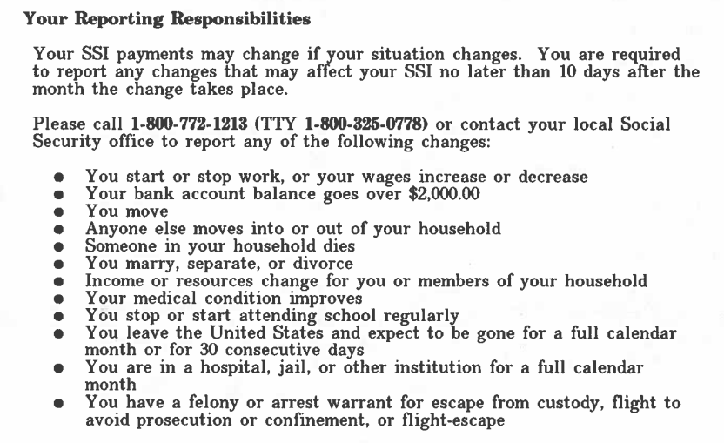

Slide 21
SSI Eligibility Income and Resources (AND SSI MEDICAID)
For a child, they will look at HOUSEHOLD income and resources.
Deeming Process
Individual over the age of 18, they only look at that individual’s income and resources.
Married Couples: Income and resources of spouse count if you are living together
“Holding Out”: Presenting yourself as if you are married

Slide 22
SSI Counts Income in the Month Received
Unearned Income
Living Arrangement
SSDI / CDB
Child Support (For a child SSI only 2/3 of support counts)
Unemployment Benefits
Veterans Affairs (VA) benefit
Ohio Works First (OWF) for a child
Adoption Subsidy
Lottery Winning
Inheritance
Monetary Gifts
Earned Income
Wages from Taxed Employment
Self Employment Income including any business expenses

Slide 23
SSI Living Arrangement

Slide 24
SSI Living Arrangement
Child SSI living with parents
Have to show FAMILY paying for own living expenses
If someone is providing support to the family, they will get less SSI
Child SSI living with someone other than a parent
Child has to pay for their share of living expenses
Age 18 Adult SSI– MUST START PAYING FOR LIVING EXPENSES – even if Age 18 redetermination hasn’t happened yet. Will go back to 18th Birthday.
SOMEONE ON SSI MUST BE PAYING FOR ALL OF THEIR OWN LIVING EXPENSES TO BE ELIGIBLE FOR MAXIMUM SSI

Slide 25
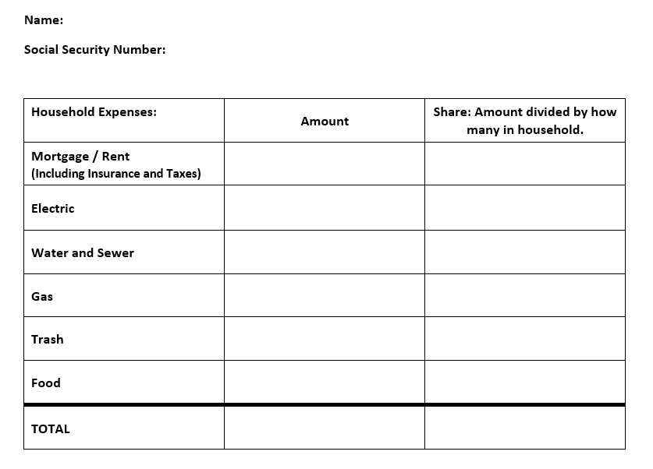

Slide 26
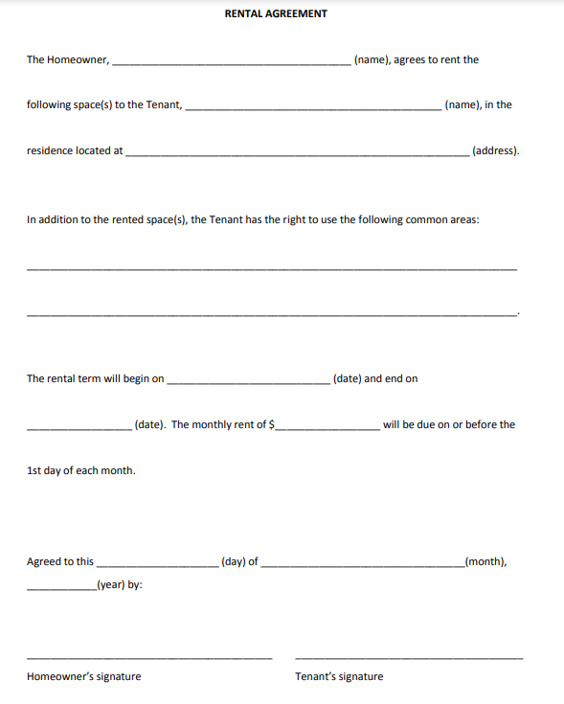

Slide 27
Temporary Living Arrangement and SSI
Jail
Suspended if in for 30 continuous days
Terminated if in for 12 continuous months
Hospitalization & Nursing Home
If Medicaid is paying for more than ½ of your cost of care, an SSI recipient would only get $30 per month for personal needs
Special Rule for folks in Medical Facility for less than 90 days that need funds to maintain living arrangement for when they get discharged
Form SSA 186
If you leave the country for 30 consecutive days.

Slide 28
SSI Income ESTIMATES
If Social Security THINKS income is received, they will estimate.
Unearned Income
Living Arrangement
Child Support
OWF Benefit
Earned Income
Estimates stay on record until proof submitted

Slide 29
Examples of UNDERPAYMENT of SSI
Child Support!
If there’s an order it will count.
Have to show monthly proof of amount received (or not received) by providing Payment History Report.
JFS OWF benefit for a child.
Should end when SSI starts.
SSI will not increase though until official JFS letter showing end date is sent to Social Security.
Employment ending.
REPORT IT by calling them!
WRITE “LAST PAYSTUB” ON THE LAST PAYSTUB THAT YOU SEND IN.

Slide 30
SSI: What Counts as Resources
Cash
Bank Accounts (Checking and Savings)
401 K – from previous employers
Items with a title (car, boat, RV, motorcycle, trailer)
Stocks
Savings Bonds
CD
Anything of VALUE (That can be converted to cash)
Life Insurance Policy ($1,500 excluded)

Slide 31
SSI: Some things that DON’T COUNT!
1 Vehicle for and Individual and Family that is used for transportation
House that YOU LIVE IN
Federal Tax Refund- doesn’t count as income or as a resource until 12 months after received
Social Security back payments – doesn’t count as income or a resource until 9 months after received
STABLE Account funds (Up to $100,000)
401K from current employer

Slide 32
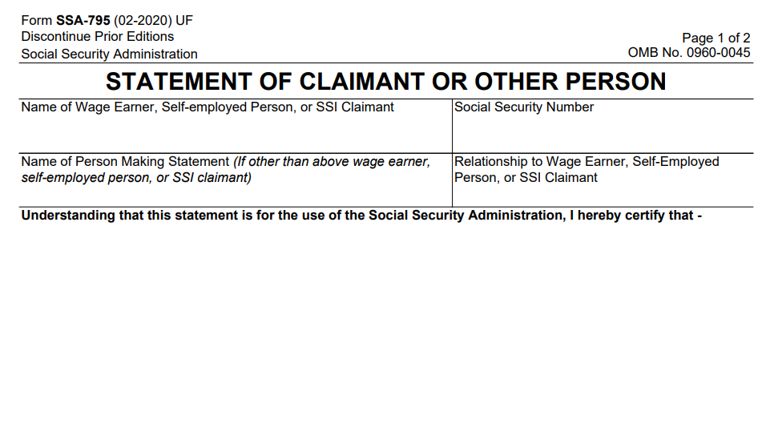

Slide 33
Work Incentive Information to Report
Student Earned Income Exclusion (For SSI up to Age 22)
IRWE’s (For SSI and SSDI / CDB)
Blind Work Expenses (For SSI)
Subsidy Form SSA 3033 (For SSDI / CDB)
Work Activity Report Form SSA 821 (For SSDI / CDB)

Slide 34
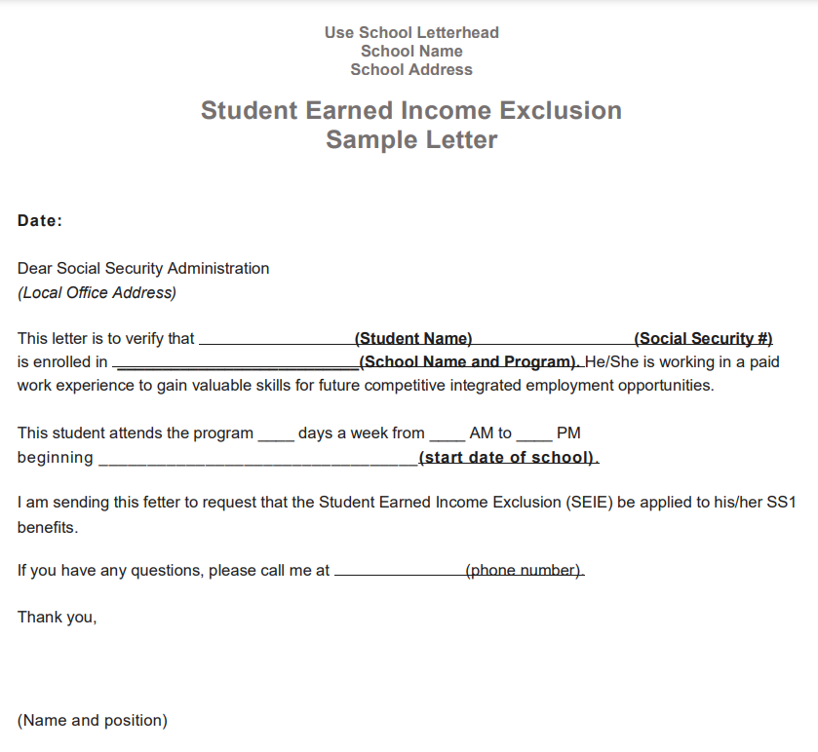

Slide 35
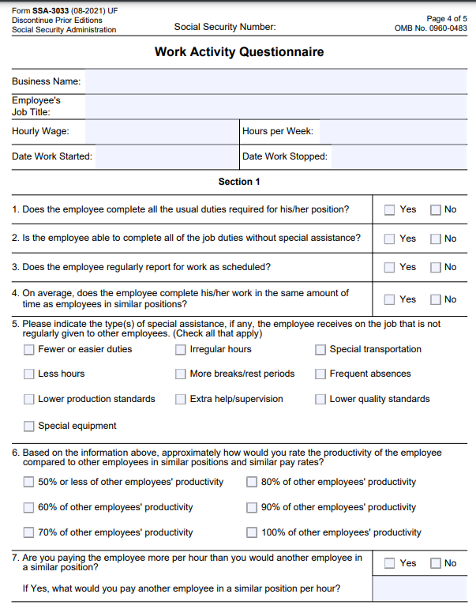
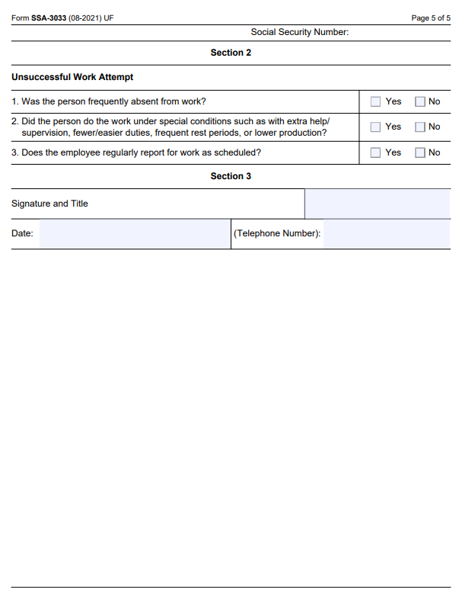

Slide 36
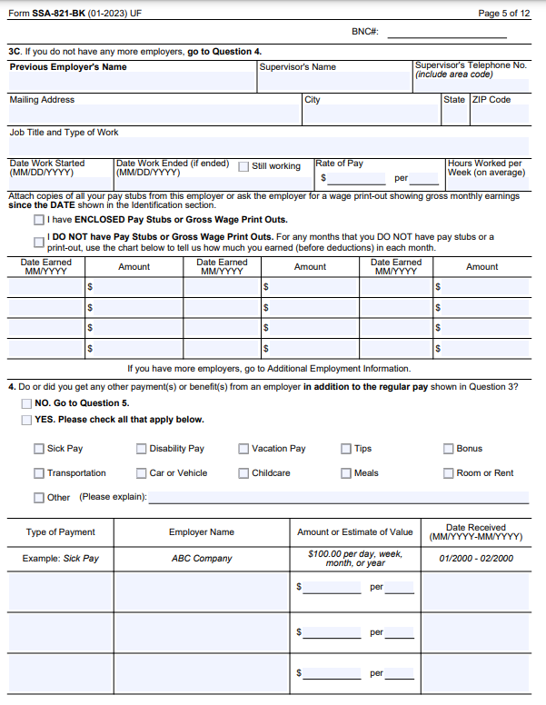
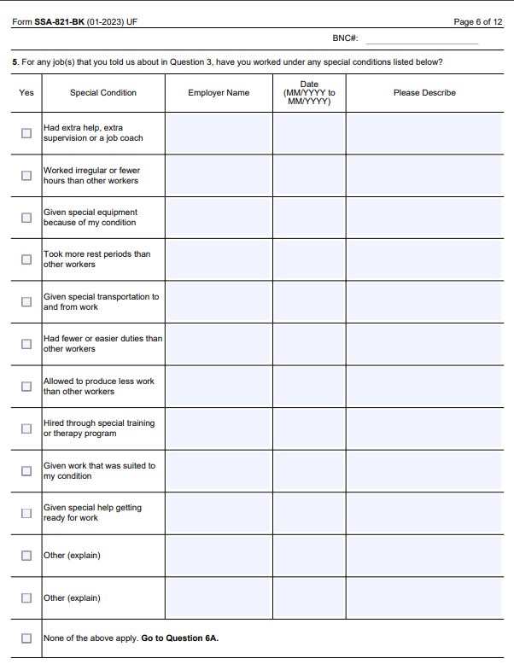

Slide 37
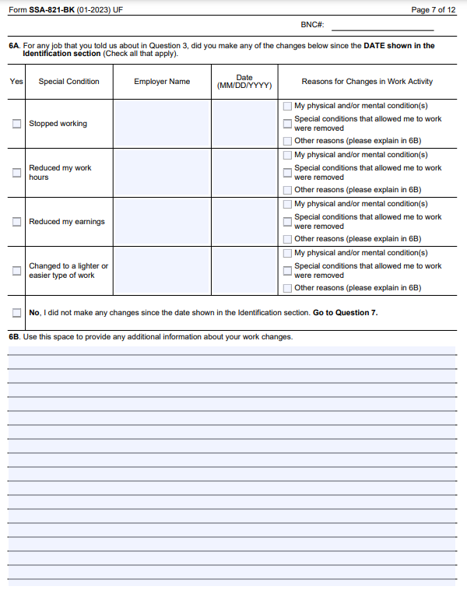
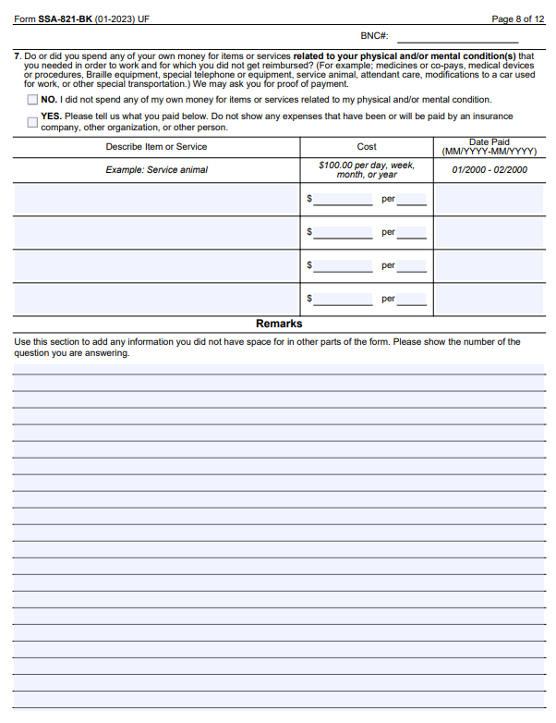

Slide 38
How to Report Information to Social Security?
Take it to a Local Social Security Office (Christine’s favorite)
Call the LOCAL Social Security Office
Mail the Information Snail Mail Style (last resort)
FAX it to them!!! (Paula’s favorite)
Office Locator: https://secure.ssa.gov/ICON/main.jsp#officeResults

Slide 39
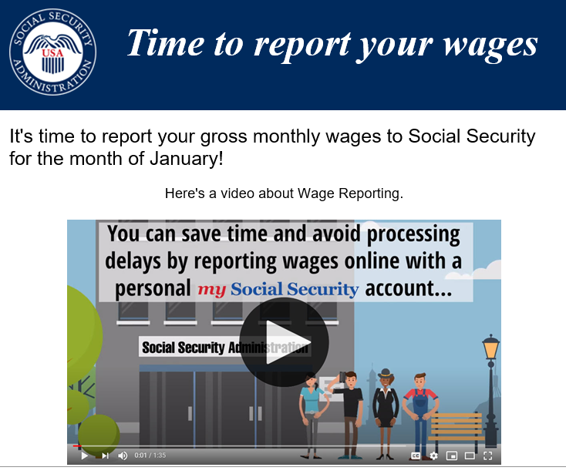
Sign up to receive email reminders for reporting wages!!!!
Report Wages Video

Slide 40
Job and Family Services Benefits
Medicaid
MANY different types with various income and resource limits
Supplemental Nutrition Assistance Program (SNAP)
Benefits based on Household size
Income below 130% FPL
Medicare Premium Assistance Programs
Medicaid helps pay out of pocket costs associated with Medicare
QMB 100% FPL / SLMB 120% FPL / QI 135% FPL
Notes:
FPL chart on next page

Slide 41
JFS Reporting
Each County has a JFS Office
https://jfs.ohio.gov/about/local-agencies-directory
Who is Responsible for Reporting to JFS?
Individual
Authorized Representative
Each county might have specific forms that you can use to report Information
Employment Verification Form
JFS caseworker MUST help get verifications if you need help, but you often must give them authorization.

Slide 42
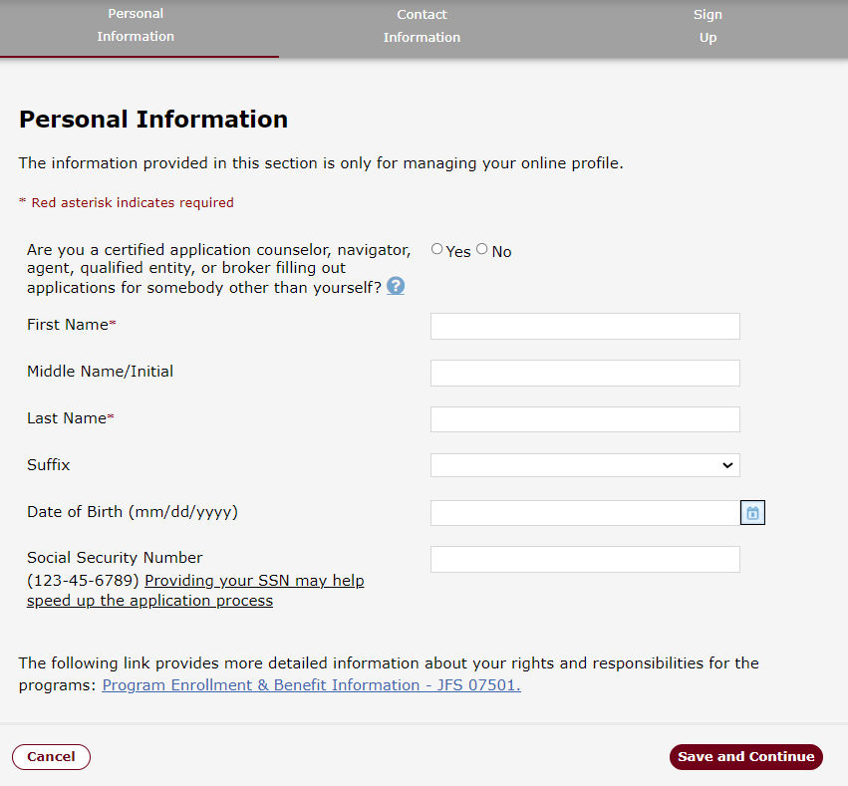
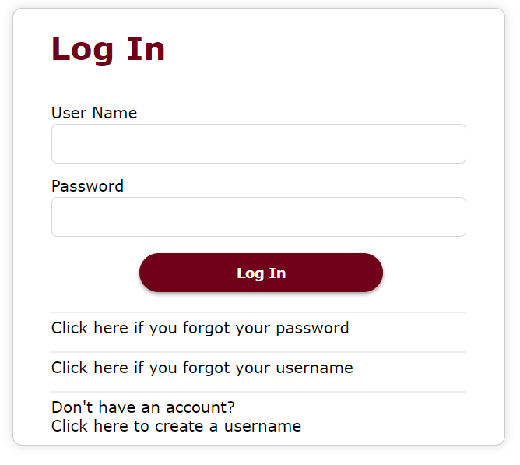
JFS Online Portal https://ssp.benefits.ohio.gov/apspssp/ssp.portal/login/doView

Slide 43
Medicaid Income and Resource Verifications
Income
Proof of Social Security Benefits
Proof of any other Unearned Income
Last 6 weeks of Pay Stub Information
Resources
Same rules as SSI for what counts
Most Recent Bank Statements
STABLE Accounts do NOT count towards limits, but they will ask for verification

Slide 44
SNAP Benefits
Allotment is based on household size and household income
Deductions apply for Rental Expenses and Utility Expenses
Send copy of Rental Agreement
Send copies of Utility Bills
20% Earned Income Deduction
Interim Reports sent out every 6 months
Must report other changes if they happen within 10 days
SNAP Change Reporting Form

Slide 45
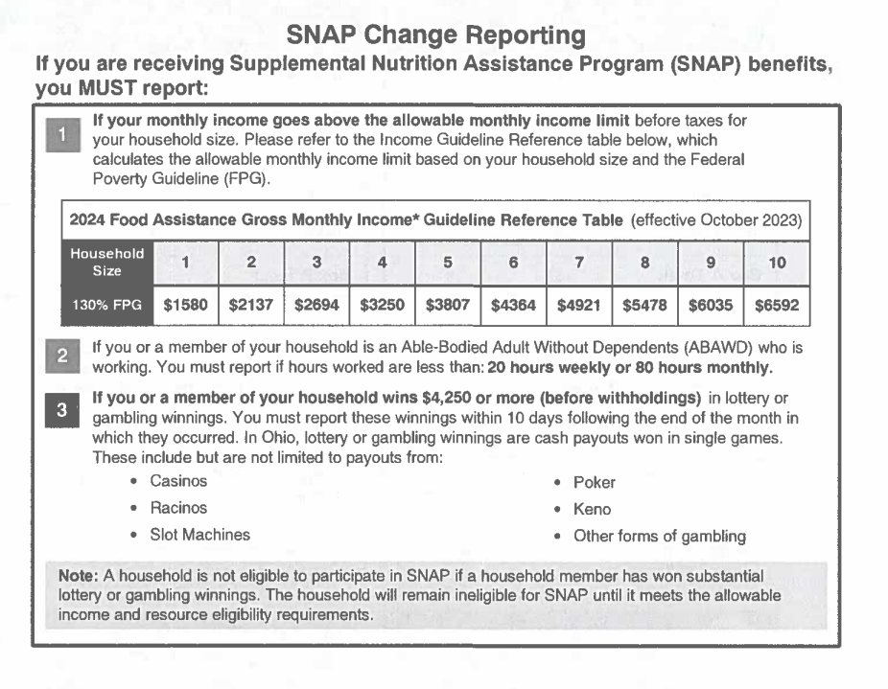
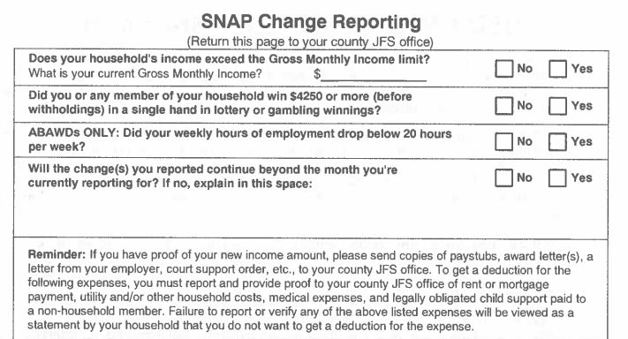

Slide 46
Housing/Rental Assistance Reporting
Report changes in your employment, income and family size within 10 days
Report any information requested by the housing authority (i.e., paystubs)
Provide notification of intent to move or relocate
Notify the housing authority if your landlord requests you to pay more than your established rental amount
Notify the housing authority if your landlord fails to make repairs in a timely manner
To confirm your reporting requirements and how to report changes contact your local housing authority. To find your local Housing Authority visit https://www.hud.gov/sites/dfiles/PIH/documents/PHA_Contact_Report_OH.pdf

Slide 47
Christine’s Experiences
Paystub Reporting
It’s important to HIGHLIGHT your actual hours worked.
If you have sick or vacation hours those are not counted for SSDI / CDB benefits. Write the number of gross income that counts.
When taking information into the Social Security Office, try to get a signature of the person that you are giving the information.
Always make double copies, keep one for you. Give one to them.

Slide 48
Resources
Social Security Forms
https://www.ssa.gov/forms/
Sign up for Email Reminders for Reporting Wages
https://www.ssa.gov/ssi/wage-reporting.html
Social Security Wage Reporting Video
https://www.youtube.com/watch?v=3g_9I1C6SYw
Social Security Handbook
https://www.ssa.gov/OP_Home/handbook/handbook.html
Social Security Office Locator
https://secure.ssa.gov/ICON/main.jsp#officeResults
Ohio Medicaid Rules
https://codes.ohio.gov/ohio-administrative-code/5160
Ohio SNAP Rules
https://codes.ohio.gov/ohio-administrative-code/5101:4
Ohio JFS Offices
https://jfs.ohio.gov/about/local-agencies-directory
Housing Authority Offices
https://www.hud.gov/sites/dfiles/PIH/documents/PHA_Contact_Report_OH.pdf

Slide 49
Poll # 3: What’s Next? More support + training on…
Medicaid Buy-In for Workers with Disabilities Updates
Work Incentives for Older Adults
How will work impact housing, transportation, and food assistance benefits?
Make sense of all the resources!
Other? (share in the chat)

Slide 50
Next Episode
STABLE Updates coming June 4th, 2024 at 2pm!

Slide 51
Questions?

