Slide 1
Welcome to the Opening Session! April 22, 2025 | 10:00 am – 12:00 pm

Slide 2
Today's Agenda
10:00am-10:20am | Welcome and Activity
10:20am-10:55am | Panelists: Partnership for Inclusion, Finding Your Voice, Supported Decision Making, Supportive Technology, Wellness, Future Board Members, Transportation, Community Connections
10:55am-11:00am | Break
11:00am-11:30am | Side by Side Learning
11:30am-11:50am | Panelists: Independence, Dungeons, Dragons and Decisions, Building Relationships with Your DSP, and County Boards Leading Community Partnerships
11:50am-12:00pm | Wrap-Up and Questions

Slide 3
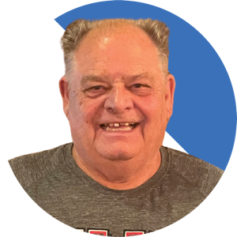
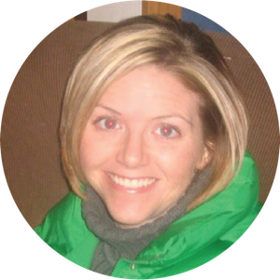
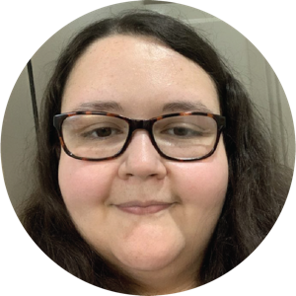
(1) Introducing the Planning Team
John Hannah Ohio Self Determination Assoc.
Angie Blake Department of Developmental Disabilities
Buffy Enochs Ohio Self Determination Assoc.

Slide 4
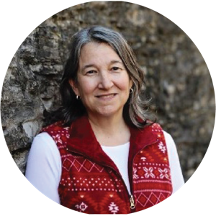
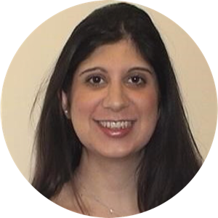
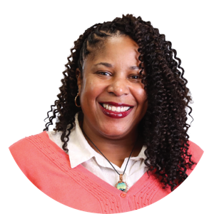
(2) Introducing the Planning Team
Lynne Fogel Ohio Department of Health
Anne Tapia Department of Developmental Disabilities
Robyn Norman Department of Developmental Disabilities

Slide 5
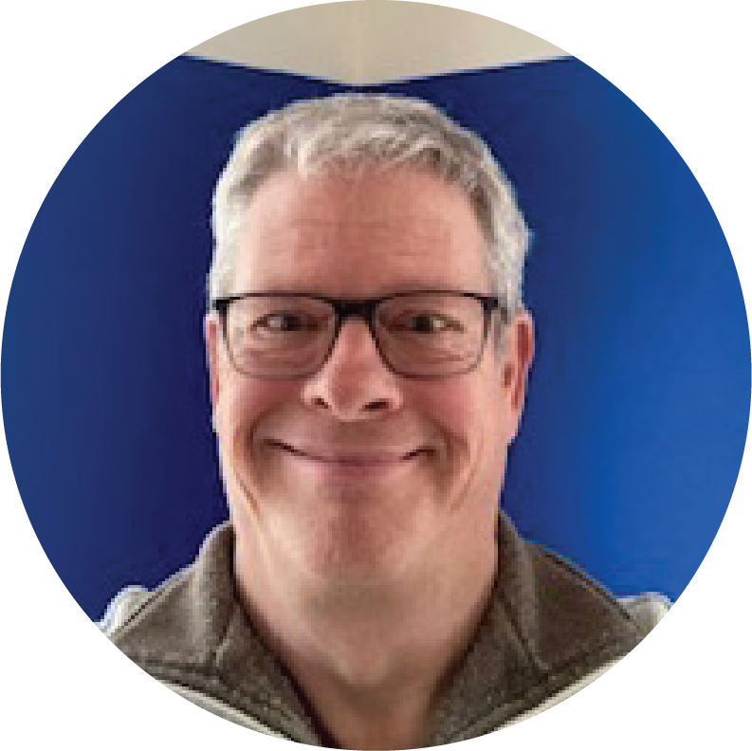
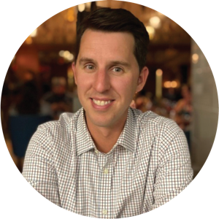
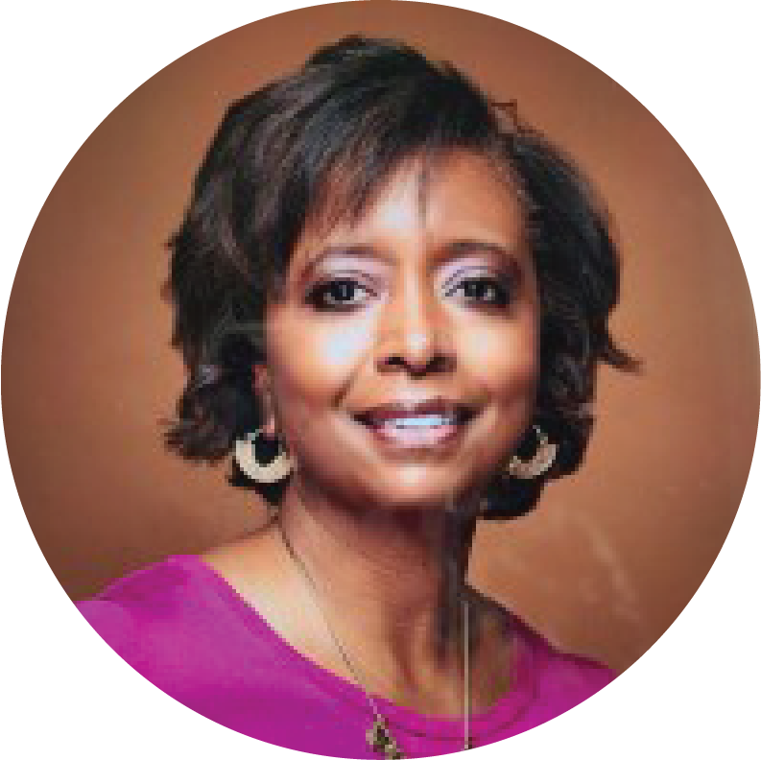
(3) Introducing the Planning Team
Kurt Lofton Goodwill Columbus
Alex Corwin Lifespan Transitions Center at OCALI
Tiffany Madden Department of Developmental Disabilities

Slide 6
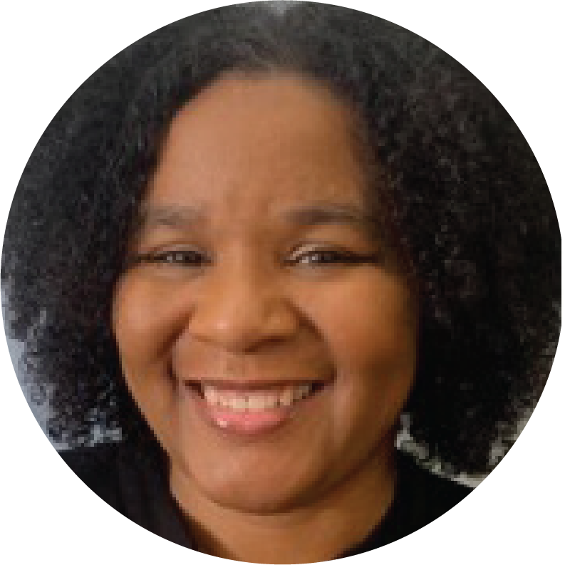
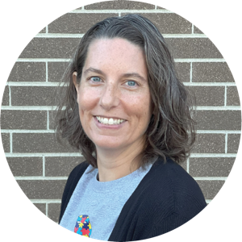
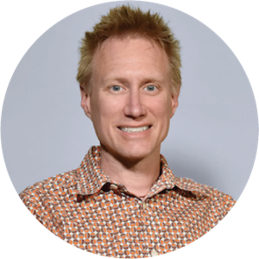
(4) Introducing the Planning Team
December West Ohio Department of Health
Shannon Keiser Fulton County Board of Developmental Disabilities
Simon Buehrer OCALI

Slide 7
Innovation Means Partnership

Slide 8
What does "Innovation Means Partnership" mean to you?
Add 1-2 words in the chat

Slide 9
Innovation Summit Objectives
Empower Yourself: Discover strategies to advocate for your needs, take charge of your decisions, and explore leadership opportunities to shape your future.
Build Stronger Teams: Gain practical tools to foster positive, productive relationships with your team and enhance collaboration.
Inspire Change Through Partnerships: Hear powerful stories from individuals who’ve successfully partnered with community organizations to create inclusive opportunities and deepen community connections.
Prioritize Your Well-Being: Learn actionable ways to nurture your physical, emotional, social, and creative health so you can be the best version of yourself.

Slide 10
Innovation Summit Overview
June 5, 2025 | Agenda
8:30am-9:30am | Registration Check-In and Networking
9:30am-10:30am | Welcome and Opening Remarks
10:30am-10:45am | Break
10:45am-11:45am | Breakout Session 1
11:45am-1:00pm | Lunch
1:00pm-2:00pm | Breakout Session 2
2:00pm-2:15pm | Snack Break
2:15pm-3:15pm | Breakout Session 3
3:15pm-4:00pm | Team Time and Closing

Slide 11
Partnerships for Inclusion in Rural Counties
Learn how counties have partnered for inclusive fair events and programs.
And how AgrAbility can support people with disabilities in the agricultural industry.

Slide 12
Pitch Perfect: Finding Your Voice With Your SSA
Does anyone in the audience have an SSA or are you an SSA? Have you ever wondered about any of the following questions?
How does your SSA get to know you better to help serve you better?
How do you get to know your SSA if they're new to you or new to the field?
How can advocates feel more comfortable talking to their SSA?
How does a person who doesn't have a "loud voice" make sure their story gets told and their needs get met?
Join our session to learn about these questions and more from our panel of advocates, those who help support advocates, and SSAs!

Slide 13
Supported Decision Making as the Preferred Alternative to Guardianship
Notes:
Drop Link to Website in Chat:
https://dodd.ohio.gov/your-family/advocacy/SDM-Toolkit

Slide 14
Supportive Technology: A Key Tool for Ohio’s DD System
Topics for Session Discussion:
Increasing Safety, Independence, and Control (Focused on individuals with developmental disabilities, spotlight on Wood County Tech Hub)
Meeting Needs Through Tech (Aimed at DSPs, providers, and families)
Technology Across the Lifespan (From Early Intervention to Adulthood with a focus on transitioning from school to adult life)
New Waiver Service, Health Care Assessment (HCA): – Delivers real-time clinical insights – Helps avoid unnecessary ER visits

Slide 15
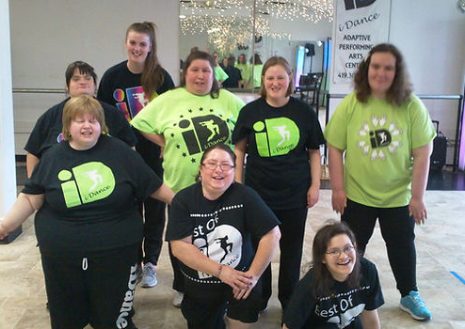
Incorporating Wellness
iDance
We Thrive Together
DODD Wellness Project
Let's Practice Now! Interactive Wellness Activity

Slide 16
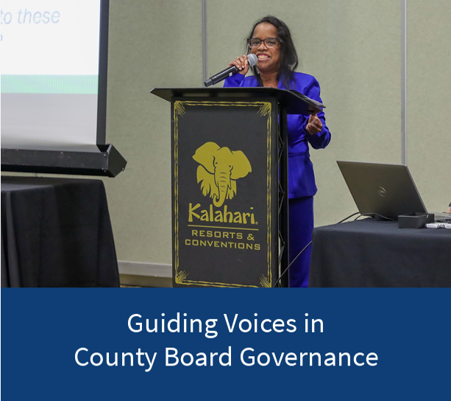
Training the Future Board Member

Slide 17
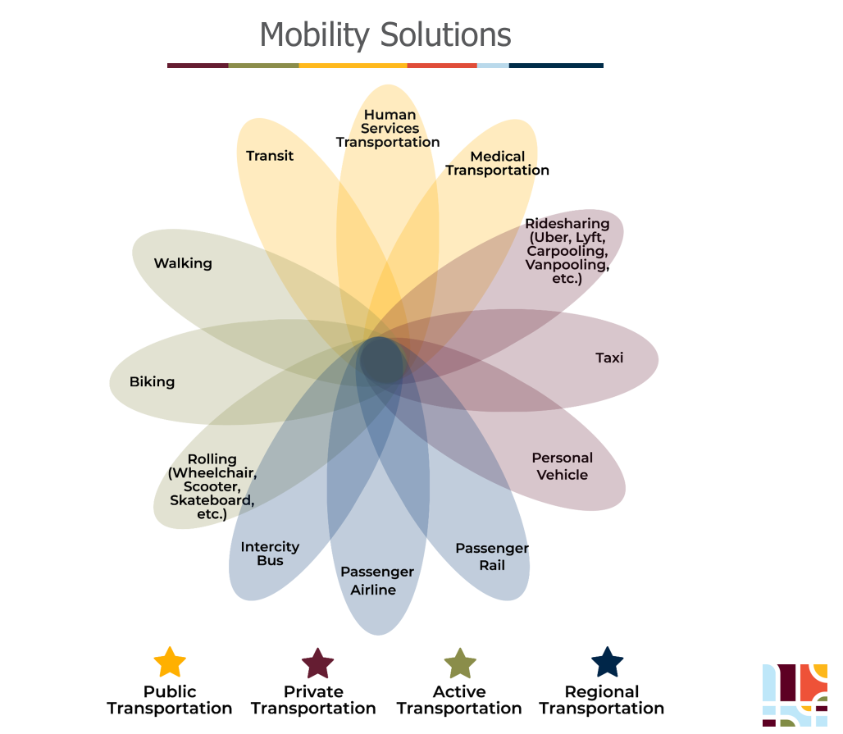
(1) Transportation is a Journey, Not a Destination

Slide 18
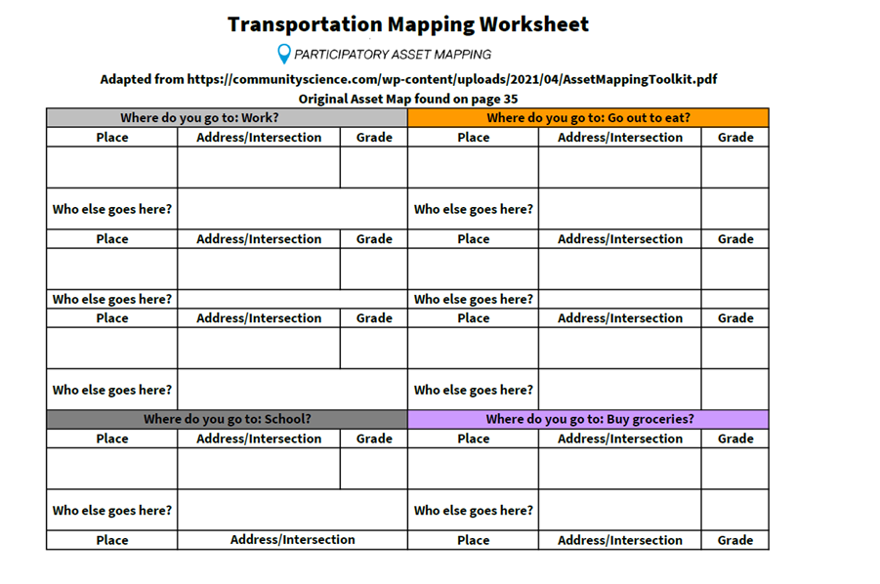
(2) Transportation is a Journey, Not a Destination
Amando, A.N. (2013). Friends: Connecting people with disabilities and community members. Minneapolis, MN: University of Minnesota, Institute on Community Integration, Research and Training Center on Community Living. https://rtc.umn.edu/friends/
Burns, J.C., Pudrzynska Paul, D., and Paz, S.R. (2012). Participatory Asset Mapping: A community research lab Toolkit. Los Angeles, CA: Catalyst California, Healthy City. https://communityscience.com/wp-content/uploads/2021/04/AssetMappingToolkit.pdf

Slide 19
What are Community Connections?

Slide 20
Report Out on Quillo: A Charting the LifeCourse App
Watch How Nate and Molly are using LifeCourseConnect
Notes:
Share video link in chat: https://www.youtube.com/watch?v=QqanVF7M69s

Slide 21
5-Minute Break!
Notes:
Simon add video with timer and music

Slide 22
What is Side-by-Side Learning?
Learning together
Everyone has a seat at the table
“Nothing about us without us!”

Slide 23
The Impact of Side-by-Side Learning

Slide 24
Ideas for Side-by-Side Learning
Know the Rule 5123-2-08 Appendix C
2-hours of training provided by the department or by an entity using department provided curriculum in topics relevant to the DSP's duties including:
NADSP Code of Ethics
Rights of Individuals set forth in section 5123.62 of the Revised Code
Empathy Based Care

Slide 25
(1) More Ideas for Side-by-Side Learning
Six hours of training
Health and Welfare Alerts
Components of Quality Care
Interpersonal relationships
Trust
Cultural competency
Effective communication
Person-centered philosophy, planning, practice
Implementing OhioISPs
Trauma informed care
Empathy based care

Slide 26
(2) More Ideas for Side-by-Side Learning
Six hours of training continued...
Health and Safety
Signs and symptoms of illness or injury
Procedure for responding
Transportation safety

Slide 27
(3) More Ideas for Side-by-Side Learning
Six hours of training continued...
Positive Behavior Support
Creating positive culture
General requirements for behavior support strategies
Role of DSP in documenting
Crisis intervention techniques

Slide 28
How to Document Side-by-Side Trainings
Does everyone who participates receive a certificate?
Is there a Sign-in sheet or list of attendees?
Is there an agenda or power point?
How to use the DODD Training Form?

Slide 29
DODD Training Documentation Form

Slide 30
Side by Side Learning
Zoom Poll
Have you engaged in a side-by-side learning opportunity?
If yes, what was your takeaway? (In 1-2 words)

Slide 31
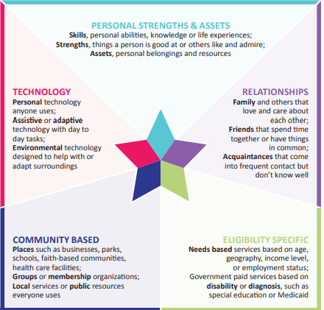
What Does Being Independent Really Mean?
Redefining independence through real stories and the power of partnership
Everyone relies on a mix of supports- people, technology, community, personal strengths, and paid services

Slide 32
Dungeons & Dragons & Decisions

Slide 33
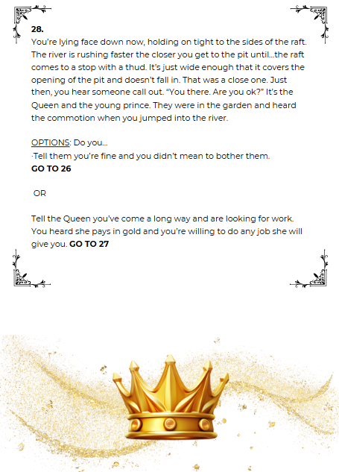
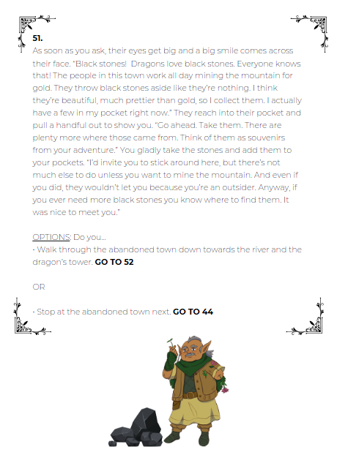
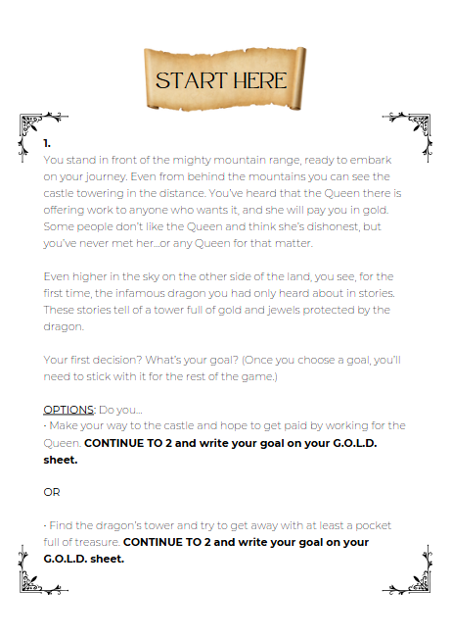
Choose Your Own Adventure

Slide 34
Training Series Principles
SELF-DETERMINATION
SUPPORTED DECISION-MAKING
GAME-BASED LEARNING

Slide 35
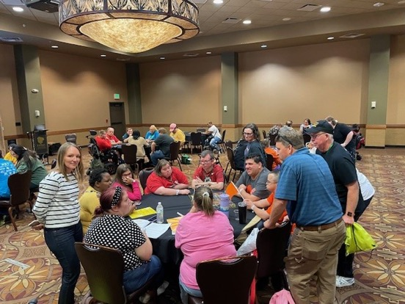
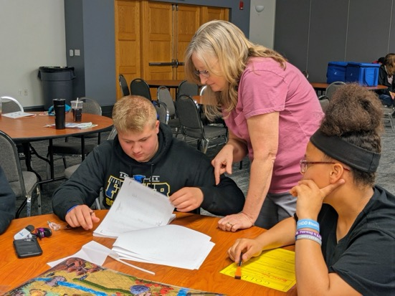
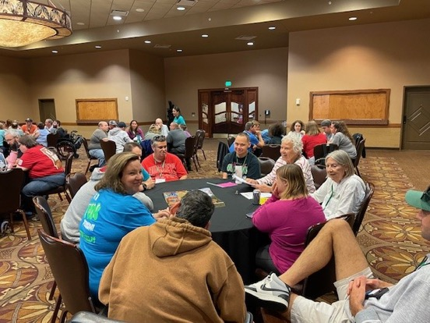
Dungeons & Dragons & Decisions Demo Session

Slide 36
Ohio Network for Innovation

Slide 37
Building Relationships with Your DSP
Making sure you know what is and is not in your OhioISP.
Understanding how to choose your provider and DSP.
How to positively work through challenging times with your DSP.
Advocating for independence with your DSP.

Slide 38
CBDDs Leading Community Inclusion Through Partnerships
Learn about key partners who can help you build a more accessible and inclusive community.
Identify roles and responsibilities that people served by your County Board can lead to help build inclusive communities

Slide 39
You Told Us Today...

Slide 40
Thank You for Joining Us Today!
Please complete the survey!
Must be completed for Continuing Professional Development Units (CPDU) certificate.
The survey link will also be emailed to you.
Notes:
Send registration link in chat https://ohioemploymentfirst.org/innovation-series
CPDU information/survey link: https://www.surveymonkey.com/r/2025InnovationKickOff
Email us at: events@ocali.org

Slide 41
Register Now for the In-Person Summit!
Thursday, June 5, 2025
9:30 am – 4:00 pm
Quest Conference Center
Westerville, OH
Register at:
ohioemploymentfirst.org
Notes:
Registration link:
https://ohioemploymentfirst.org/innovation-series

Slide 42
Questions and Answers

Slide 43
Thank you!
See you at the Innovation Summit on June 5!

